Slide 1
Agenda
Question and Answers
Manual Entry of Payment

Slide 2
Manual Entry of Payment
Apart from receiving, parsing and processing Payment messages, PEX system is also be able to accept payments through manual (UI) entry.
System does validate, store and further process these payments.
Manually created payment consists of one CT Instruction, containing one or more transactions.

Slide 3
Supported Payment Messages (1)
The SWIFT MTs supported are:
SWIFT MT103
SWIFT MT202
SWIFT MT202-COV
SWIFT MT200
SWIFT MT210
SWIFT MT190, MT290
SWIFT MT191, MT291
It is, however, possible to extend the number of supported SWIFT MTs.

Slide 4
Supported Payment Messages (2)
The manual entry of a SWIFT MT Instruction can either result in an “inbound” or “outbound” Instruction.
An inbound SWIFT MT is as if it is received from SWIFT. The Bank is then the receiver.
An outbound SWIFT MT is as if the SWIFT MT is initiated by the Bank (and potentially sent out as a SWIFT MT). The Bank is in that case the sender.
Manual entry of a SWIFT MT Instruction can also be initiated by selecting a template that uses a SWIFT MT instruction type. In this case, the fields are pre-populated with the values that are stored in the template.

Slide 5
Supported Payment Messages (3)
Supported SWIFT MTs | Inbound | Outbound
SWIFT MT200 | X | X
SWIFT MT202 | X
SWIFT MT202-COV | X
SWIFT MT103 | X
SWIFT MT191, MT291 |  | X
SWIFT MT190, MT290 |  | X
SWIFT MT210 |  | X

Slide 6
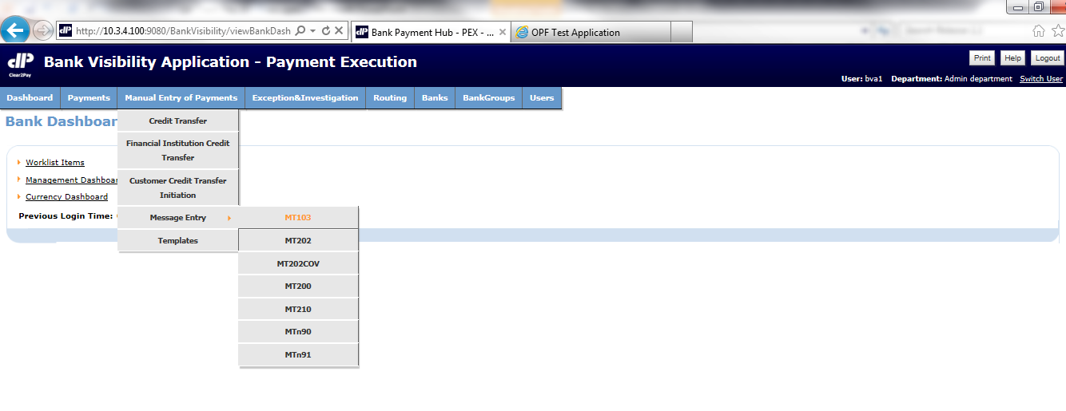
Manual Entry Screen
Manual entry screen on BVA allows user to enter payments manually

Slide 7
Manual Entry Steps
1
User Navigates to Manual Entry screen and selects required message type.
Manual entry of payment is done by user on BVA screen.
2
On successful creation of payment, a message is displayed on screen to indicate that payment has been successfully created and is pending 4-eye verification.
Instruction status is “Awaiting 4EV”.
3
In case user is not able to create the payment then invalid fields are highlighted and an error message is displayed for each invalid field.
User is presented with the screen to correct the issues.

Slide 8
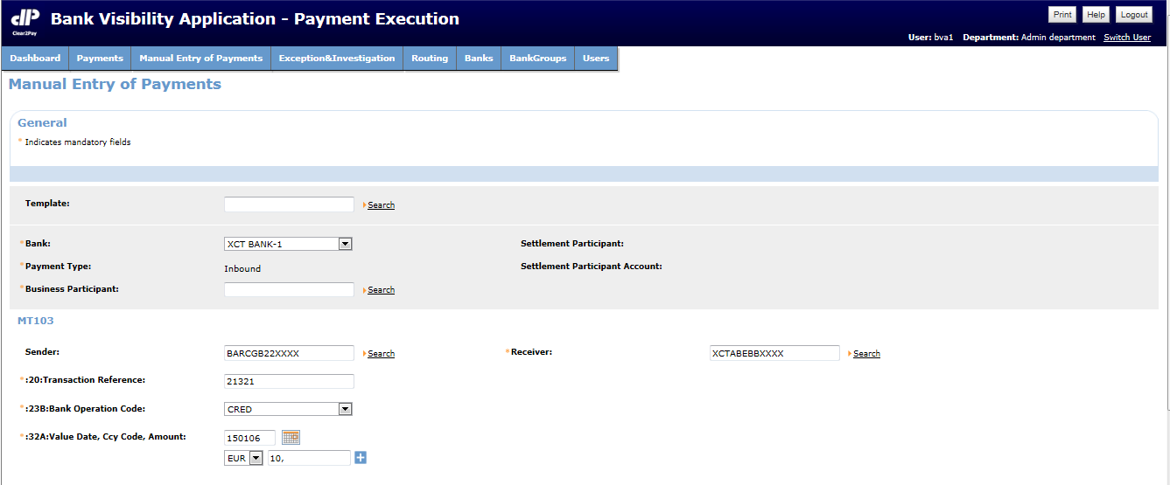
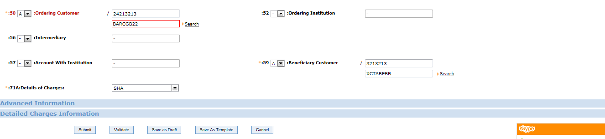
Manual Entry Example Screens (1)
Provide mandatory fields
Click on Submit Button

Slide 9
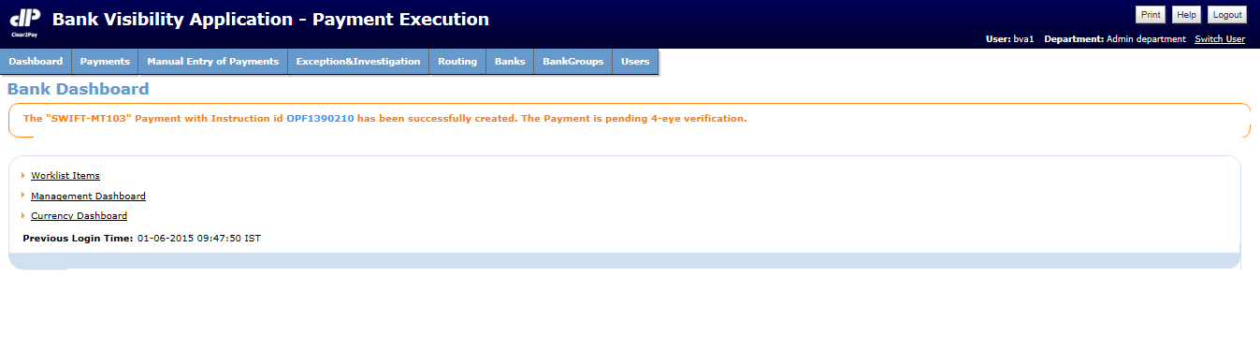
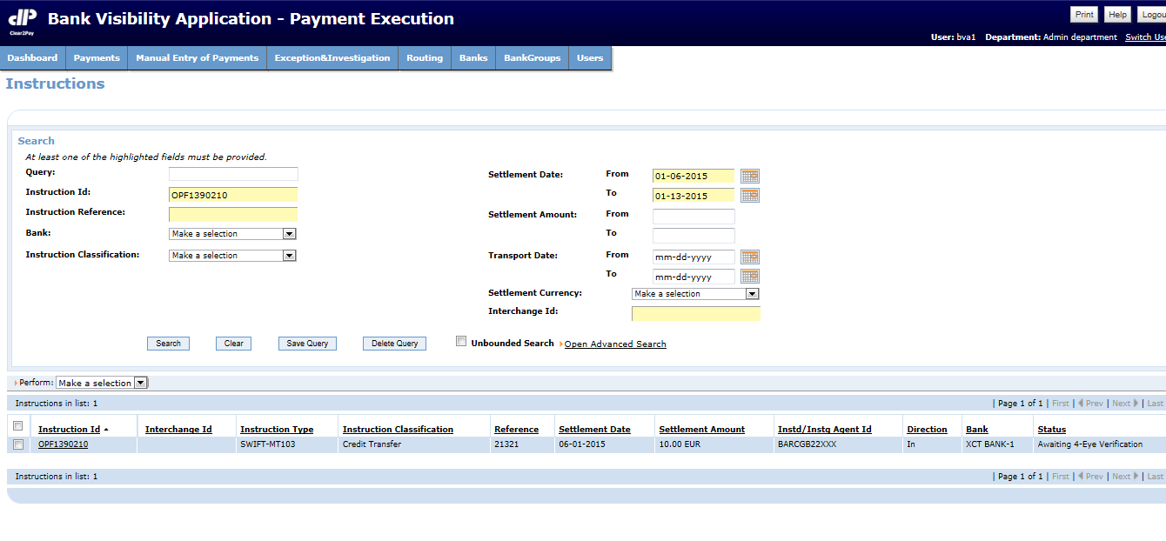
Manual Entry Example Screens (2)
On successful creation of payment,
system message is displayed on screen
Status of Inx/Trx is Awaiting 4EV

Slide 10
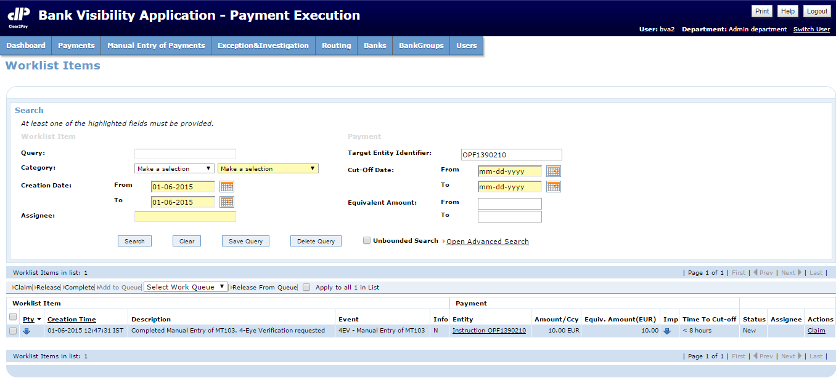
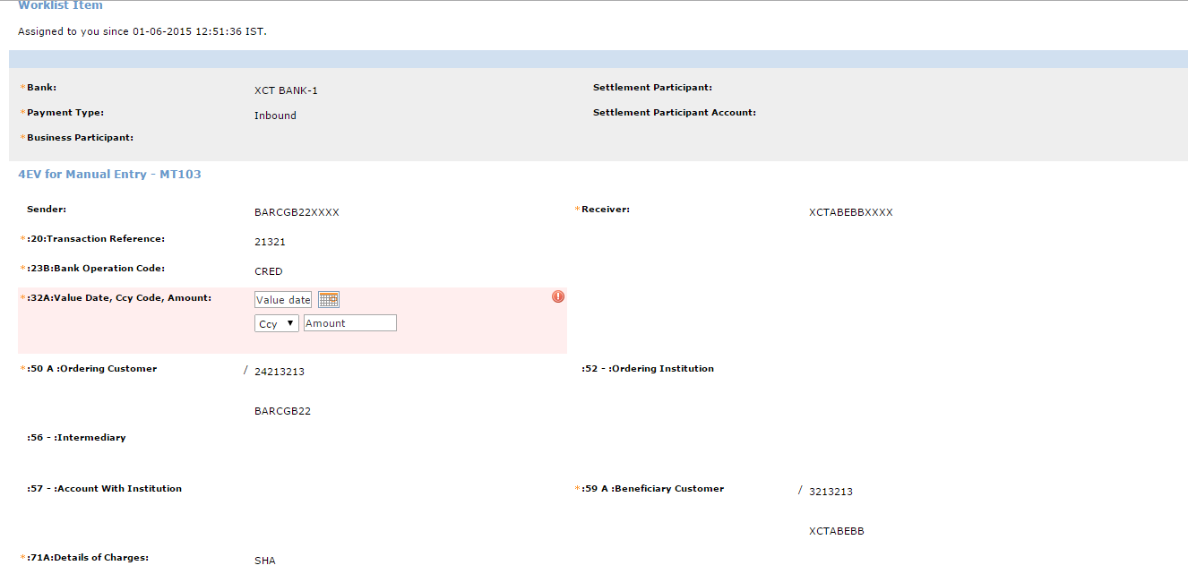
Manual Entry Example Screens (3)
Login with another User,
Search and ‘Claim’ related WLI
Provide data if required

Slide 11
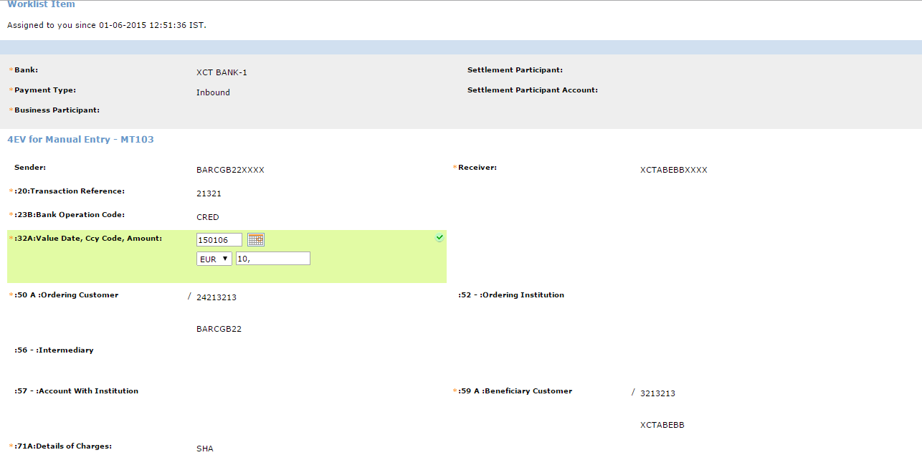
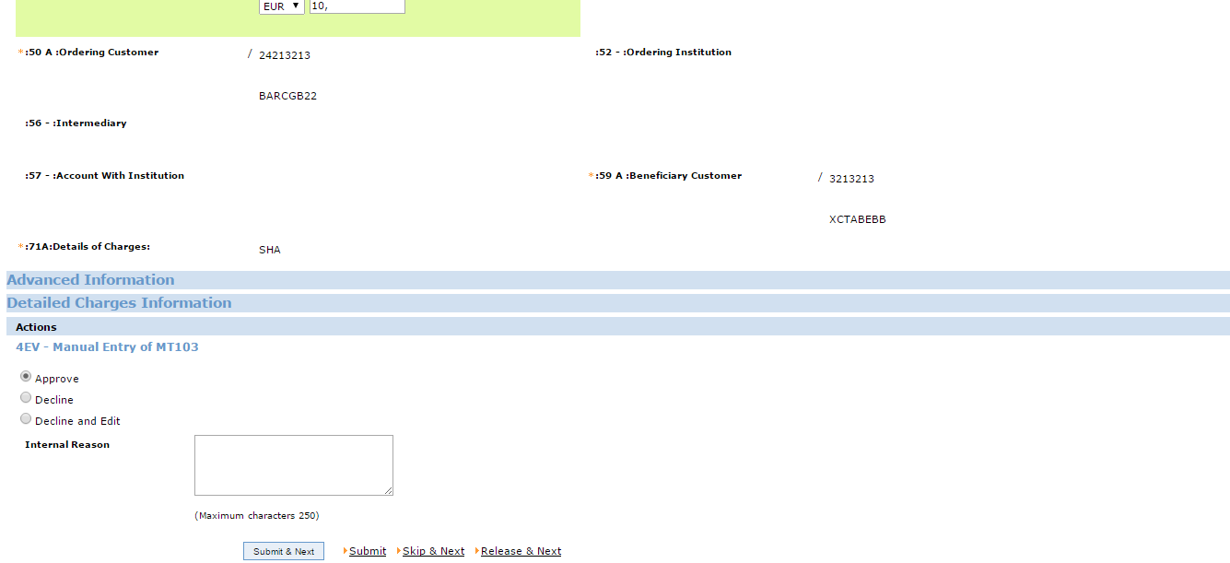
Manual Entry Example Screens (4)
Take 4EV Action

Slide 12
4EV Actions on Manual Entry
Approve
The system updates the status of the Instruction and all the associated Transactions to “Created”
Decline
The system updates the status of the Instruction and all the associated Transactions to “Draft”
Decline and Edit
User can Edit the details and ‘Submit’ the changes.
The system updates the status of the Instruction and all the associated Transactions to “Awaiting 4 Eye Verification”

Slide 13

Question & Answers
Open your mind and let the thoughts flow around

Slide 14
EMEA – Headquarters
Brussels, Belgium
info@clear2pay.com
APAC
Sydney, Australia
info.apac@clear2pay.com
Americas
Atlanta, USA
info.americas@clear2pay.com
www.clear2pay.com

